Slide 1
Global Initiative for Asthma (GINA) What’s new in GINA 2019?
This slide set is restricted for academic and educational purposes only. No additions or changes may be made to slides. Use of the slide set or of individual slides for commercial or promotional purposes requires approval from GINA.

Slide 2
About the GINA strategy
The GINA report is not a guideline, but an integrated evidence-based strategy focusing on translation into clinical practice
Recommendations are framed, not as answers to isolated PICOT questions, but as part of an integrated strategy, in relation to:
The GINA goals of preventing asthma deaths and exacerbations, as well as improving symptom control
Current understanding of underlying disease processes
Human behavior (of health professionals and patients/carers)
Implementation in clinical practice
Global variation in populations, health systems and medication access
For new therapies, 2 good quality studies + indication by EMA/FDA are required
For existing medications with established safety profile, GINA may sometimes make off-label recommendations for new indications (e.g. macrolides for severe asthma)

Slide 3
Background to changes in 2019 - the risks of ‘mild’ asthma
Patients with apparently mild asthma are at risk of serious adverse events
30–37% of adults with acute asthma
16% of patients with near-fatal asthma
15–20% of adults dying of asthma
Exacerbation triggers are variable (viruses, pollens, pollution, poor adherence)
Inhaled SABA has been first-line treatment for asthma for 50 years
This dates from an era when asthma was thought to be a disease of bronchoconstriction
Patient satisfaction with, and reliance on, SABA treatment is reinforced by its rapid relief of symptoms, its prominence in ED and hospital management of exacerbations, and low cost
Patients commonly believe that “My reliever gives me control over my asthma”, so they often don’t see the need for additional treatment
had symptoms less than weekly in previous 3 months (Dusser, Allergy 2007)
Notes:
Dusser D, Montani D, Chanez P, de Blic J, Delacourt C, Deschildre A, Devillier P, et al. Mild asthma: an expert review on epidemiology, clinical characteristics and treatment recommendations. Allergy 2007;62:591-604.
Reddel HK, Ampon RD, Sawyer SM, Peters MJ. Risks associated with managing asthma without a preventer: urgent healthcare, poor asthma control and over-the-counter reliever use in a cross-sectional population survey. BMJ open 2017;7:e016688.
Hancox RJ, Cowan JO, Flannery EM, Herbison GP, McLachlan CR, Taylor DR. Bronchodilator tolerance and rebound bronchoconstriction during regular inhaled beta-agonist treatment. Respir Med 2000;94:767-71.
Aldridge RE, Hancox RJ, Robin Taylor D, Cowan JO, Winn MC, Frampton CM, Town GI. Effects of terbutaline and budesonide on sputum cells and bronchial hyperresponsiveness in asthma. Am J Respir Crit Care Med 2000;161:1459-64.
Stanford RH, Shah MB, D’Souza AO, Dhamane AD, Schatz M. Short-acting β-agonist use and its ability to predict future asthma-related outcomes. Annals of Allergy, Asthma & Immunology 2012;109:403-7.
Suissa S, Ernst P, Boivin JF, Horwitz RI, Habbick B, Cockroft D, Blais L, et al. A cohort analysis of excess mortality in asthma and the use of inhaled beta-agonists. Am J Respir Crit Care Med 1994;149:604-10.

Slide 4
Background to changes in 2019 - the risks of SABA-only treatment
Regular or frequent use of SABA is associated with adverse effects
β-receptor downregulation, decreased bronchoprotection, rebound hyperresponsiveness, decreased bronchodilator response (Hancox, Respir Med 2000)
Increased allergic response, and increased eosinophilic airway inflammation (Aldridge, AJRCCM 2000)
Higher use of SABA is associated with adverse clinical outcomes
Dispensing of ≥3 canisters per year (average 1.7 puffs/day) is associated with higher risk of emergency department presentations (Stanford, AAAI 2012)
Dispensing of ≥12 canisters per year is associated with higher risk of death (Suissa, AJRCCM 1994)
Notes:
Reddel HK, Ampon RD, Sawyer SM, Peters MJ. Risks associated with managing asthma without a preventer: urgent healthcare, poor asthma control and over-the-counter reliever use in a cross-sectional population survey. BMJ open 2017;7:e016688.
Hancox RJ, Cowan JO, Flannery EM, Herbison GP, McLachlan CR, Taylor DR. Bronchodilator tolerance and rebound bronchoconstriction during regular inhaled beta-agonist treatment. Respir Med 2000;94:767-71.
Aldridge RE, Hancox RJ, Robin Taylor D, Cowan JO, Winn MC, Frampton CM, Town GI. Effects of terbutaline and budesonide on sputum cells and bronchial hyperresponsiveness in asthma. Am J Respir Crit Care Med 2000;161:1459-64.
Stanford RH, Shah MB, D’Souza AO, Dhamane AD, Schatz M. Short-acting β-agonist use and its ability to predict future asthma-related outcomes. Annals of Allergy, Asthma & Immunology 2012;109:403-7.
Suissa S, Ernst P, Boivin JF, Horwitz RI, Habbick B, Cockroft D, Blais L, et al. A cohort analysis of excess mortality in asthma and the use of inhaled beta-agonists. Am J Respir Crit Care Med 1994;149:604-10.

Slide 5
The 12-year history behind changes in GINA 2019
Since 2007, GINA has been actively seeking interventions for mild asthma
to reduce the risk of asthma-related exacerbations and death
to provide consistent messaging about the goals of asthma treatment, including prevention of exacerbations, across the spectrum of asthma severity
to avoid establishing patient reliance on SABA early in the course of the disease
GINA emphasized poor adherence as a modifiable risk factor for exacerbations
When the reliever is SABA, poor adherence with maintenance controller exposes the patient to risks of SABA-only treatment
GINA members repeatedly sought funding for RCTs of as-needed ICS-formoterol for risk reduction in mild asthma
Eventually culminated in 2014 with the initiation of the SYGMA studies, published in 2018 (O’Byrne NEJMed 2018; Bateman NEJMed 2018)
Notes:
Four GINA members (O’Byrne, Bateman, FitzGerald, Reddel) sought funding from AstraZeneca, Chiesi, and government agencies. Depending on the context of the presentation, you may want to explain that, although GINA’s focus was on risk reduction, the regulator required the primary outcome for SYGMA 1 to be a ‘control’ measure that would be relevant to all patients. The measure that was used (electronically recorded well-controlled asthma weeks, eWCAW) was systematically biased against the ICS-formoterol arm; a patient in the ICS group could take 14 doses of ICS in a week and still be counted as having a well-controlled week, whereas if a patient in the budesonide-formoterol arm took 5 doses of ICS-formoterol in a week, the week was automatically counted as not well-controlled.

Slide 6
The 12-year history behind changes in GINA 2019
In the meantime, GINA challenged conventional criteria for initiation of ICS
During preparation for 2014 GINA revision, we identified no evidence for the recommendation to withhold ICS until symptoms were more than twice weekly
This was investigated in a post hoc analysis of START data (Pauwels, Lancet 2003). This found that ICS halved the risk of serious exacerbations even in patients with symptoms 0-1 days a week at entry (Reddel, Lancet 2017)
GINA found no evidence to support a Step 1 SABA-only recommendation
The lack of evidence for SABA-only treatment contrasted with the strong evidence for safety, efficacy and effectiveness of treatments recommended in Steps 2-5
In 2014, as an interim safety measure, GINA restricted SABA-only treatment to patients with symptoms less than twice a month and no risk factors for exacerbations
2018: Review of evidence for mild asthma, including SYGMA studies
A careful review of GINA conflict of interest processes was undertaken first
Notes:
If relevant, you can say that the inclusion criteria for SYGMA 1 and 2 were based on the GINA 2012 report (i.e. based on the conventional criterion of symptoms >twice/week for starting ICS), as the GINA 2014 report had not been published when the SYGMA protocols were finalized

Slide 7
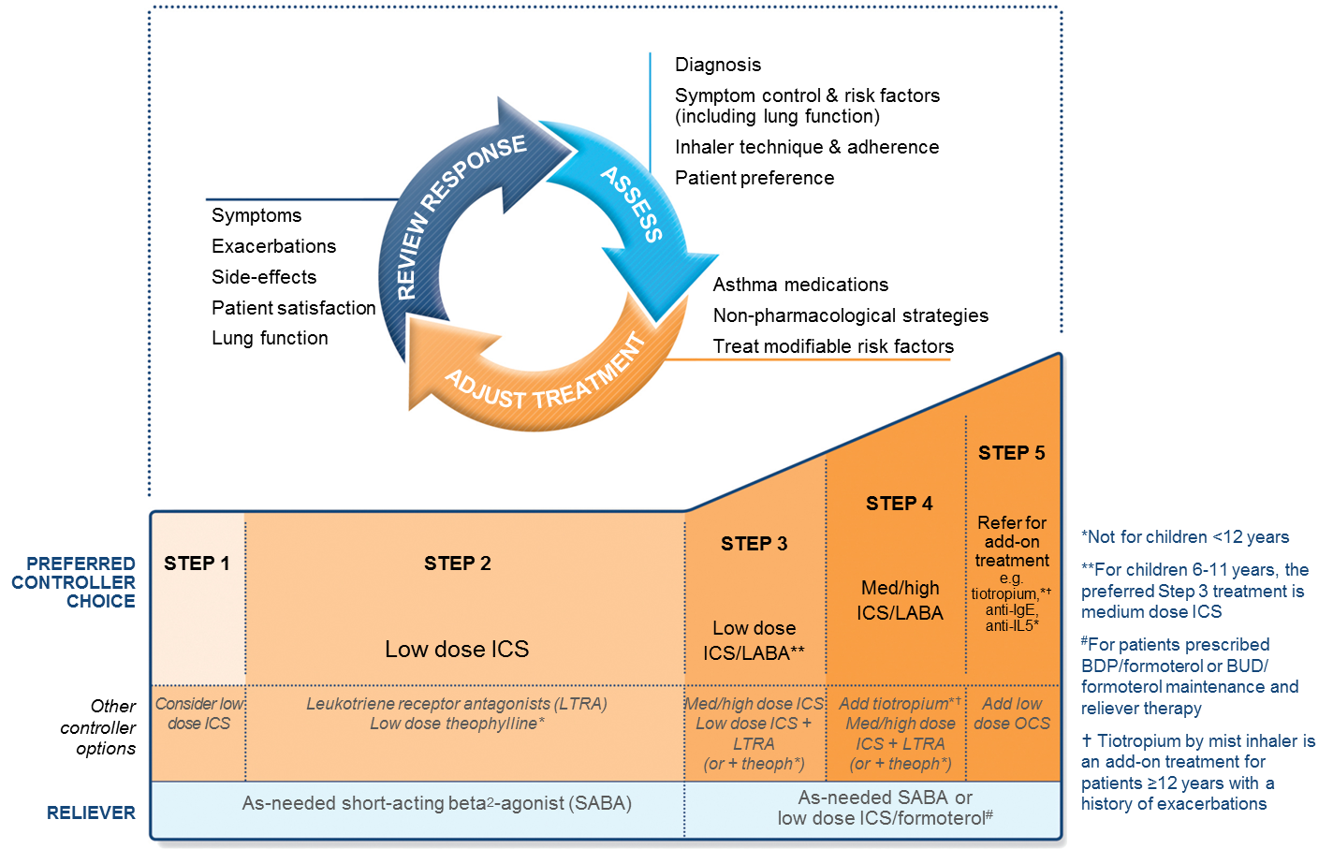
GINA 2018 – main treatment figure
Step 1 treatment is for patients with symptoms <twice/month and no risk factors for exacerbations
Previously, no controller was recommended for Step 1, i.e. SABA-only treatment was ‘preferred’
GINA 2018, Box 3-5 (2/8) (upper part)

Slide 8
GINA 2019 – landmark changes in asthma management
For safety, GINA no longer recommends SABA-only treatment for Step 1
This decision was based on evidence that SABA-only treatment increases the risk of severe exacerbations, and that adding any ICS significantly reduces the risk
GINA now recommends that all adults and adolescents with asthma should receive symptom-driven or regular low dose ICS-containing controller treatment, to reduce the risk of serious exacerbations
This is a population-level risk reduction strategy, e.g. statins, anti-hypertensives
Notes:
With population-level risk reduction strategies, short-term clinical benefit may not necessarily be seen in individual patients. The aim is to reduce the probability of serious adverse outcomes at a population level.

Slide 9

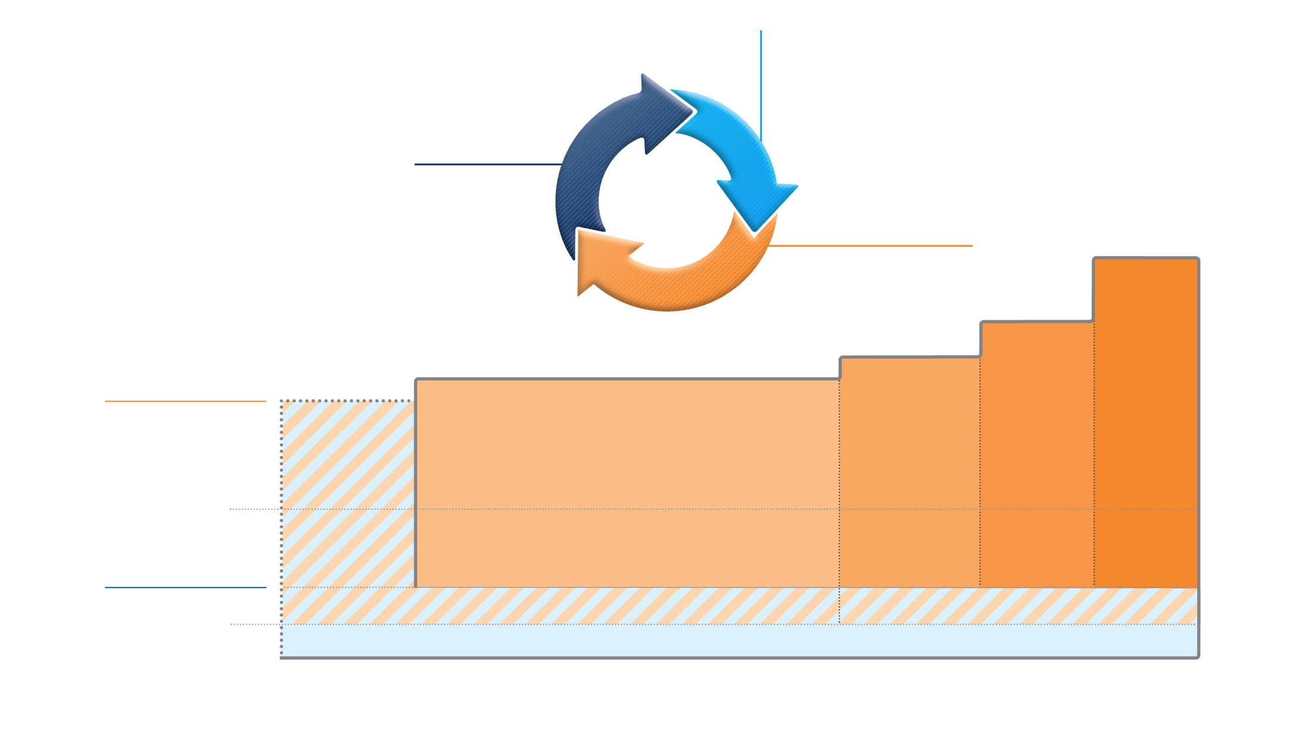
Box 3-5A
Adults & adolescents 12+ years
Confirmation of diagnosis if necessary Symptom control & modifiable
risk factors (including lung function)
Comorbidities
Inhaler technique & adherence Patient goals
ASSESS
Personalized asthma management:
Assess, Adjust, Review response
REVIEW RESPONSE
Symptoms Exacerbations Side-effects Lung function
Patient satisfaction
ADJUST
Treatment of modifiable risk factors & comorbidities
Non-pharmacological strategies Education & skills training Asthma medications
STEP 5
High dose ICS-LABA
Refer for phenotypic assessment
± add-on therapy, e.g.tiotropium, anti-IgE,
anti-IL5/5R,
anti-IL4R
Asthma medication options: Adjust treatment up and down for individual patient needs
STEP 4
Medium dose ICS-LABA
STEP 3
Low dose ICS-LABA
STEP 2
Daily low dose inhaled corticosteroid (ICS), or as-needed low dose ICS-formoterol *
PREFERRED CONTROLLER
to prevent exacerbations and control symptoms
STEP 1
As-needed low dose
ICS-formoterol *
Other controller options
Low dose ICS taken whenever SABA is taken †
Leukotriene receptor antagonist (LTRA), or low dose ICS taken whenever SABA taken †
Medium dose ICS, or low dose ICS+LTRA #
High dose ICS, add-on tiotropium, or add-on LTRA #
Add low dose OCS, but consider
side-effects
PREFERRED RELIEVER
As-needed low dose ICS-formoterol *
As-needed low dose ICS-formoterol ‡
Other reliever option
As-needed short-acting β₂ -agonist (SABA)
* Off-label; data only with budesonide-formoterol (bud-form)
† Off-label; separate or combination ICS and SABA inhalers
‡ Low-dose ICS-form is the reliever for patients prescribed bud-form or BDP-form maintenance and reliever therapy
# Consider adding HDM SLIT for sensitized patients with allergic rhinitis and FEV >70% predicted
© Global Initiative for Asthma, www.ginasthma.org
1
Notes:
Comment that we have made the figure in landscape orientation, so that the arrowed circle will always be seen

Slide 10
Box 3-5A
Adults & adolescents 12+ years
Confirmation of diagnosis if necessary Symptom control & modifiable
risk factors (including lung function)
Comorbidities
Inhaler technique & adherence Patient goals
ASSESS
Personalized asthma management:
Assess, Adjust, Review response
REVIEW RESPONSE
Symptoms Exacerbations Side-effects Lung function
Patient satisfaction
ADJUST
Treatment of modifiable risk factors & comorbidities
Non-pharmacological strategies Education & skills training Asthma medications
STEP 5
High dose ICS-LABA
Refer for phenotypic assessment
± add-on therapy, e.g.tiotropium, anti-IgE,
anti-IL5/5R,
anti-IL4R
Asthma medication options: Adjust treatment up and down for individual patient needs
STEP 4
Medium dose ICS-LABA
STEP 3
Low dose ICS-LABA
STEP 2
Daily low dose inhaled corticosteroid (ICS), or as-needed low dose ICS-formoterol *
PREFERRED CONTROLLER
to prevent exacerbations and control symptoms
STEP 1
As-needed low dose
ICS-formoterol *
Other controller options
Low dose ICS taken whenever SABA is taken †
Leukotriene receptor antagonist (LTRA), or low dose ICS taken whenever SABA taken †
Medium dose ICS, or low dose ICS+LTRA #
High dose ICS, add-on tiotropium, or add-on LTRA #
Add low dose OCS, but consider
side-effects
PREFERRED RELIEVER
As-needed low dose ICS-formoterol *
As-needed low dose ICS-formoterol ‡
Other reliever option
As-needed short-acting β₂ -agonist (SABA)
* Off-label; data only with budesonide-formoterol (bud-form)
† Off-label; separate or combination ICS and SABA inhalers
‡ Low-dose ICS-form is the reliever for patients prescribed bud-form or BDP-form maintenance and reliever therapy
# Consider adding HDM SLIT for sensitized patients with allergic rhinitis and FEV >70% predicted
© Global Initiative for Asthma, www.ginasthma.org
1
Notes:
This slide is animated to show the emphasis on personalised treatment, and that treatment doesn’t mean just medications, but also treatment of modifiable risk factors and comorbidities, and non-pharmacological strategies

Slide 11
Box 3-5A
Adults & adolescents 12+ years
Confirmation of diagnosis if necessary Symptom control & modifiable
risk factors (including lung function)
Comorbidities
Inhaler technique & adherence Patient goals
ASSESS
Personalized asthma management:
Assess, Adjust, Review response
REVIEW RESPONSE
‘Controller’ treatment means the treatment taken to prevent exacerbations
Symptoms Exacerbations Side-effects Lung function
Patient satisfaction
ADJUST
Treatment of modifiable risk factors & comorbidities
Non-pharmacological strategies Education & skills training Asthma medications
STEP 5
High dose ICS-LABA
Refer for phenotypic assessment
± add-on therapy, e.g.tiotropium, anti-IgE,
anti-IL5/5R,
anti-IL4R
Asthma medication options: Adjust treatment up and down for individual patient needs
STEP 4
Medium dose ICS-LABA
STEP 3
Low dose ICS-LABA
STEP 2
Daily low dose inhaled corticosteroid (ICS), or as-needed low dose ICS-formoterol *
PREFERRED CONTROLLER
to prevent exacerbations and control symptoms
STEP 1
As-needed low dose
ICS-formoterol *
Other controller options
Low dose ICS taken whenever SABA is taken †
Leukotriene receptor antagonist (LTRA), or low dose ICS taken whenever SABA taken †
Medium dose ICS, or low dose ICS+LTRA #
High dose ICS, add-on tiotropium, or add-on LTRA #
Add low dose OCS, but consider
side-effects
PREFERRED RELIEVER
As-needed low dose ICS-formoterol *
As-needed low dose ICS-formoterol ‡
Other reliever option
As-needed short-acting β₂ -agonist (SABA)
* Off-label; data only with budesonide-formoterol (bud-form)
† Off-label; separate or combination ICS and SABA inhalers
‡ Low-dose ICS-form is the reliever for patients prescribed bud-form or BDP-form maintenance and reliever therapy
# Consider adding HDM SLIT for sensitized patients with allergic rhinitis and FEV >70% predicted
© Global Initiative for Asthma, www.ginasthma.org
1

Slide 12
Step 2 – rationale for changes in GINA 2019

Slide 13
Box 3-5A
Adults & adolescents 12+ years
Confirmation of diagnosis if necessary Symptom control & modifiable
risk factors (including lung function)
Comorbidities
Inhaler technique & adherence Patient goals
ASSESS
Personalized asthma management:
Assess, Adjust, Review response
REVIEW RESPONSE
Symptoms Exacerbations Side-effects Lung function
Patient satisfaction
ADJUST
Treatment of modifiable risk factors & comorbidities
Non-pharmacological strategies Education & skills training Asthma medications
STEP 5
High dose ICS-LABA
Refer for phenotypic assessment
± add-on therapy, e.g.tiotropium, anti-IgE,
anti-IL5/5R,
anti-IL4R
Asthma medication options: Adjust treatment up and down for individual patient needs
STEP 4
Medium dose ICS-LABA
STEP 3
Low dose ICS-LABA
STEP 2
Daily low dose inhaled corticosteroid (ICS), or as-needed low dose ICS-formoterol *
PREFERRED CONTROLLER
to prevent exacerbations and control symptoms
STEP 1
As-needed low dose
ICS-formoterol *
Other controller options
Low dose ICS taken whenever SABA is taken †
Leukotriene receptor antagonist (LTRA), or low dose ICS taken whenever SABA taken †
Medium dose ICS, or low dose ICS+LTRA #
High dose ICS, add-on tiotropium, or add-on LTRA #
Add low dose OCS, but consider
side-effects
PREFERRED RELIEVER
As-needed low dose ICS-formoterol *
As-needed low dose ICS-formoterol ‡
Other reliever option
As-needed short-acting β₂ -agonist (SABA)
* Off-label; data only with budesonide-formoterol (bud-form)
† Off-label; separate or combination ICS and SABA inhalers
‡ Low-dose ICS-form is the reliever for patients prescribed bud-form or BDP-form maintenance and reliever therapy
# Consider adding HDM SLIT for sensitized patients with allergic rhinitis and FEV >70% predicted
© Global Initiative for Asthma, www.ginasthma.org
1

Slide 14
Step 2 – there are two ‘preferred’ controller options
Regular low dose ICS with as-needed SABA
Evidence
A large body of evidence from RCTs and observational studies that low dose ICS substantially reduces risks of severe exacerbations, hospitalizations and death e.g. Suissa, NEJMed 2000; Suissa, Thorax 2002; Pauwels, Lancet 2003; O’Byrne, AJRCCM 2001
Serious exacerbations halved even in patients with symptoms 0-1 days per week (Reddel, Lancet 2017)
Improved symptom control and reduced exercise-induced bronchoconstriction
Values and preferences
High importance was given to preventing asthma deaths and severe exacerbations
However, we were aware that poor adherence is common in mild asthma in the community, and that this would expose patients to the risks of SABA-only treatment

Slide 15
Step 2 – two ‘preferred’ controller options
As-needed low dose ICS-formoterol (off-label; all evidence with budesonide-formoterol)
Evidence
Direct evidence from two large studies of non-inferiority for severe exacerbations vs daily low dose ICS + as-needed SABA (O’Byrne, NEJMed 2018, Bateman, NEJMed 2018)
Direct evidence from one large study of 64% reduction in severe exacerbations vs SABA-only treatment (O’Byrne, NEJMed 2018)
Symptoms reduced; one study showed reduced exercise-induced bronchoconstriction
Values and preferences
High importance was given to preventing severe exacerbations, avoiding need for daily ICS in patients with mild or infrequent symptoms, and safety of as-needed ICS-formoterol in maintenance and reliever therapy, with no new safety signals
Lower importance given to small non-cumulative differences in symptom control (ACQ-5 difference 0.15 vs MCID 0.5) and lung function compared with daily ICS
Makes use of normal patient behavior (seeking symptom relief) to deliver controller
Notes:
All evidence to date is with low dose budesonide-formoterol, but BDP-formoterol could also potentially be used in the same way. Other ICS-rapid onset LABA formulations have a higher dose of formoterol (e.g. fluticasone propionate-formoterol, mometasone-formoterol), and do not necessarily have similar benefit from cumulative doses of these ICS

Slide 16
Box 3-5A
Adults & adolescents 12+ years
Confirmation of diagnosis if necessary Symptom control & modifiable
risk factors (including lung function)
Comorbidities
Inhaler technique & adherence Patient goals
ASSESS
Personalized asthma management:
Assess, Adjust, Review response
REVIEW RESPONSE
Symptoms Exacerbations Side-effects Lung function
Patient satisfaction
ADJUST
Treatment of modifiable risk factors & comorbidities
Non-pharmacological strategies Education & skills training Asthma medications
STEP 5
High dose ICS-LABA
Refer for phenotypic assessment
± add-on therapy, e.g.tiotropium, anti-IgE,
anti-IL5/5R,
anti-IL4R
Asthma medication options: Adjust treatment up and down for individual patient needs
STEP 4
Medium dose ICS-LABA
STEP 3
Low dose ICS-LABA
STEP 2
Daily low dose inhaled corticosteroid (ICS), or as-needed low dose ICS-formoterol *
PREFERRED CONTROLLER
to prevent exacerbations and control symptoms
STEP 1
As-needed low dose
ICS-formoterol *
Other controller options
Low dose ICS taken whenever SABA is taken †
Leukotriene receptor antagonist (LTRA), or low dose ICS taken whenever SABA taken †
Medium dose ICS, or low dose ICS+LTRA #
High dose ICS, add-on tiotropium, or add-on LTRA #
Add low dose OCS, but consider
side-effects
PREFERRED RELIEVER
As-needed low dose ICS-formoterol *
As-needed low dose ICS-formoterol ‡
Other reliever option
As-needed short-acting β₂ -agonist (SABA)
* Off-label; data only with budesonide-formoterol (bud-form)
† Off-label; separate or combination ICS and SABA inhalers
‡ Low-dose ICS-form is the reliever for patients prescribed bud-form or BDP-form maintenance and reliever therapy
# Consider adding HDM SLIT for sensitized patients with allergic rhinitis and FEV >70% predicted
© Global Initiative for Asthma, www.ginasthma.org
1

Slide 17
Step 2 - other controller options
Low dose ICS taken whenever SABA taken (off-label, separate or combination inhalers)
Evidence
Two RCTs showed reduced exacerbations compared with SABA-only treatment
BEST, in adults, with combination ICS-SABA (Papi, NEJMed 2007)
TREXA, in children/adolescents, with separate inhalers (Martinez, Lancet 2011)
Three RCTs showed similar or fewer exacerbations compared with maintenance ICS
TREXA, BEST
BASALT in adults, separate inhalers, vs physician-adjusted treatment (Calhoun, JAMA 2012)
Values and preferences
High importance given to preventing severe exacerbations
Lower importance given to small differences in symptom control and the inconvenience of needing to carry two inhalers
Combination ICS-SABA inhalers are available in some countries, but approved only for maintenance use
Another option: leukotriene receptor antagonist (less effective for exacerbations)

Slide 18
Step 1 – rationale for changes in GINA 2019

Slide 19
Box 3-5A
Adults & adolescents 12+ years
Confirmation of diagnosis if necessary Symptom control & modifiable
risk factors (including lung function)
Comorbidities
Inhaler technique & adherence Patient goals
ASSESS
Personalized asthma management:
Assess, Adjust, Review response
REVIEW RESPONSE
Symptoms Exacerbations Side-effects Lung function
Patient satisfaction
ADJUST
Treatment of modifiable risk factors & comorbidities
Non-pharmacological strategies Education & skills training Asthma medications
STEP 5
High dose ICS-LABA
Refer for phenotypic assessment
± add-on therapy, e.g.tiotropium, anti-IgE,
anti-IL5/5R,
anti-IL4R
Asthma medication options: Adjust treatment up and down for individual patient needs
STEP 4
Medium dose ICS-LABA
STEP 3
Low dose ICS-LABA
STEP 2
Daily low dose inhaled corticosteroid (ICS), or as-needed low dose ICS-formoterol *
PREFERRED CONTROLLER
to prevent exacerbations and control symptoms
STEP 1
As-needed low dose
ICS-formoterol *
Other controller options
Low dose ICS taken whenever SABA is taken †
Leukotriene receptor antagonist (LTRA), or low dose ICS taken whenever SABA taken †
Medium dose ICS, or low dose ICS+LTRA #
High dose ICS, add-on tiotropium, or add-on LTRA #
Add low dose OCS, but consider
side-effects
PREFERRED RELIEVER
As-needed low dose ICS-formoterol *
As-needed low dose ICS-formoterol ‡
Other reliever option
As-needed short-acting β₂ -agonist (SABA)
* Off-label; data only with budesonide-formoterol (bud-form)
† Off-label; separate or combination ICS and SABA inhalers
‡ Low-dose ICS-form is the reliever for patients prescribed bud-form or BDP-form maintenance and reliever therapy
# Consider adding HDM SLIT for sensitized patients with allergic rhinitis and FEV >70% predicted
© Global Initiative for Asthma, www.ginasthma.org
1
Notes:
The dotted line around Step 1 indicates that the evidence is indirect

Slide 20
Step 1 – ‘preferred’ controller option
Step 1 is for patients with symptoms less than twice a month, and with no exacerbation risk factors
As-needed low dose ICS-formoterol (off-label)
Evidence
Indirect evidence from SYGMA 1 of large reduction in severe exacerbations vs SABA-only treatment in patients eligible for Step 2 therapy (O’Byrne, NEJMed 2018)
Values and preferences
High importance given to reducing exacerbations
High importance given to avoiding conflicting messages about goals of asthma treatment between Step 1 and Step 2
High importance given to poor adherence with regular ICS in patients with infrequent symptoms, which would expose them to risks of SABA-only treatment

Slide 21
Step 1 - other controller option
Low dose ICS taken whenever SABA is taken (off-label)
Evidence
Indirect evidence from studies in patients eligible for Step 2 treatment (BEST, TREXA, BASALT)
Values and preferences
High importance given to preventing severe exacerbations
Lower importance given to small differences in symptom control and the inconvenience of needing to carry two inhalers
Combination ICS-SABA inhalers are available in some countries, but approved only for maintenance use
Daily ICS is no longer listed as a Step 1 option
This was included in GINA 2014-18, but with high probability of poor adherence
Now replaced by more feasible as-needed controller options for Step 1

Slide 22
Other changes in GINA 2019 - Steps 3-5 for adults and adolescents

Slide 23
Box 3-5A
Adults & adolescents 12+ years
Confirmation of diagnosis if necessary Symptom control & modifiable
risk factors (including lung function)
Comorbidities
Inhaler technique & adherence Patient goals
ASSESS
Personalized asthma management:
Assess, Adjust, Review response
REVIEW RESPONSE
Step 4 treatment is medium dose ICS-LABA; high dose now in Step 5
Symptoms Exacerbations Side-effects Lung function
Patient satisfaction
ADJUST
Treatment of modifiable risk factors & comorbidities
Non-pharmacological strategies Education & skills training Asthma medications
STEP 5
High dose ICS-LABA
Refer for phenotypic assessment
± add-on therapy, e.g.tiotropium, anti-IgE,
anti-IL5/5R,
anti-IL4R
Asthma medication options: Adjust treatment up and down for individual patient needs
STEP 4
Medium dose ICS-LABA
STEP 3
Low dose ICS-LABA
STEP 2
Daily low dose inhaled corticosteroid (ICS), or as-needed low dose ICS-formoterol *
PREFERRED CONTROLLER
to prevent exacerbations and control symptoms
STEP 1
As-needed low dose
ICS-formoterol *
Other controller options
Low dose ICS taken whenever SABA is taken †
Leukotriene receptor antagonist (LTRA), or low dose ICS taken whenever SABA taken †
Medium dose ICS, or low dose ICS+LTRA #
High dose ICS, add-on tiotropium, or add-on LTRA #
Add low dose OCS, but consider
side-effects
PREFERRED RELIEVER
As-needed low dose ICS-formoterol *
As-needed low dose ICS-formoterol ‡
Other reliever option
As-needed short-acting β₂ -agonist (SABA)
* Off-label; data only with budesonide-formoterol (bud-form)
† Off-label; separate or combination ICS and SABA inhalers
‡ Low-dose ICS-form is the reliever for patients prescribed bud-form or BDP-form maintenance and reliever therapy
# Consider adding HDM SLIT for sensitized patients with allergic rhinitis and FEV >70% predicted
© Global Initiative for Asthma, www.ginasthma.org
1

Slide 24
Box 3-5A
Adults & adolescents 12+ years
Confirmation of diagnosis if necessary Symptom control & modifiable
risk factors (including lung function)
Comorbidities
Inhaler technique & adherence Patient goals
ASSESS
Personalized asthma management:
Assess, Adjust, Review response
REVIEW RESPONSE
See severe asthma Pocket Guide for details about Step 5
Symptoms Exacerbations Side-effects Lung function
Patient satisfaction
ADJUST
Treatment of modifiable risk factors & comorbidities
Non-pharmacological strategies Education & skills training Asthma medications
STEP 5
High dose ICS-LABA
Refer for phenotypic assessment
± add-on therapy, e.g.tiotropium, anti-IgE,
anti-IL5/5R,
anti-IL4R
Asthma medication options: Adjust treatment up and down for individual patient needs
STEP 4
Medium dose ICS-LABA
STEP 3
Low dose ICS-LABA
STEP 2
Daily low dose inhaled corticosteroid (ICS), or as-needed low dose ICS-formoterol *
PREFERRED CONTROLLER
to prevent exacerbations and control symptoms
STEP 1
As-needed low dose
ICS-formoterol *
Other controller options
Low dose ICS taken whenever SABA is taken †
Leukotriene receptor antagonist (LTRA), or low dose ICS taken whenever SABA taken †
Medium dose ICS, or low dose ICS+LTRA #
High dose ICS, add-on tiotropium, or add-on LTRA #
Add low dose OCS, but consider
side-effects
PREFERRED RELIEVER
As-needed low dose ICS-formoterol *
As-needed low dose ICS-formoterol ‡
Other reliever option
As-needed short-acting β₂ -agonist (SABA)
* Off-label; data only with budesonide-formoterol (bud-form)
† Off-label; separate or combination ICS and SABA inhalers
‡ Low-dose ICS-form is the reliever for patients prescribed bud-form or BDP-form maintenance and reliever therapy
# Consider adding HDM SLIT for sensitized patients with allergic rhinitis and FEV >70% predicted
© Global Initiative for Asthma, www.ginasthma.org
1

Slide 25
Changes in GINA 2019 – children 6-11 years

Slide 26
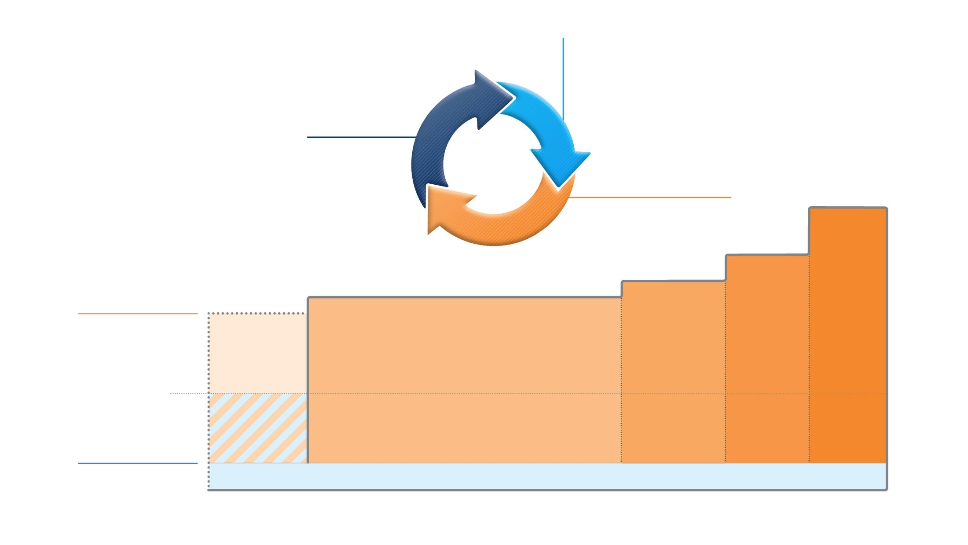
Box 3-5B
Children 6-11 years
Confirmation of diagnosis if necessary Symptom control & modifiable
risk factors (including lung function)
Comorbidities
Inhaler technique & adherence Child and parent goals
ASSESS
Personalized asthma management:
Assess, Adjust, Review response
REVIEW RESPONSE
Symptoms Exacerbations Side-effects Lung function
Child and parent satisfaction
ADJUST
Treatment of modifiable risk factors & comorbidities
Non-pharmacological strategies Education & skills training
STEP 5
Refer for phenotypic assessment
± add-on therapy,
e.g. anti-IgE
Asthma medication options: Adjust treatment up and down for individual child’s needs
Asthma medications
STEP 4
Medium dose ICS-LABA
Refer for expert advice
STEP 3
Low dose ICS-LABA, or medium dose ICS
STEP 2
PREFERRED CONTROLLER
to prevent exacerbations and control symptoms
STEP 1
Daily low dose inhaled corticosteroid (ICS) (see table of ICS dose ranges for children)
Other controller options
Low dose ICS taken whenever SABA taken*; or daily low dose ICS
Leukotriene receptor antagonist (LTRA), or low dose ICS taken whenever SABA taken*
Low dose ICS+LTRA
High dose ICS- LABA, or add- on tiotropium, or add-on LTRA
Add-on anti-IL5, or add-on low dose OCS,
but consider side-effects
RELIEVER
As-needed short-acting β₂ -agonist (SABA)
* Off-label; separate ICS and SABA inhalers; only one study in children
Notes:
State that in 2019, there is a separate treatment figure for children, rather than differences being handled with footnotes, as in the past.

Slide 27
Children 6-11 years
Step 4
Medium dose ICS-LABA, but refer for expert advice
Step 3
Low dose ICS-LABA and medium dose ICS are ‘preferred’ controller treatments
No safety signal with ICS-LABA in children 4-11 years (Stempel, NEJMed 2017)
Step 2
Preferred controller is daily low dose ICS
Other controller options include as-needed low dose ICS taken whenever SABA is taken, but only one study in children (Martinez, Lancet 2011)
Studies of as-needed ICS-formoterol are needed; maintenance and reliever therapy with low dose budesonide-formoterol in children 4-11 years reduced exacerbations by 70-79% compared with ICS and ICS-LABA (Bisgaard, Chest 2006)
Step 1
Low dose ICS whenever SABA taken (indirect evidence), or daily low dose ICS

Slide 28
Other changes in GINA 2019

Slide 29
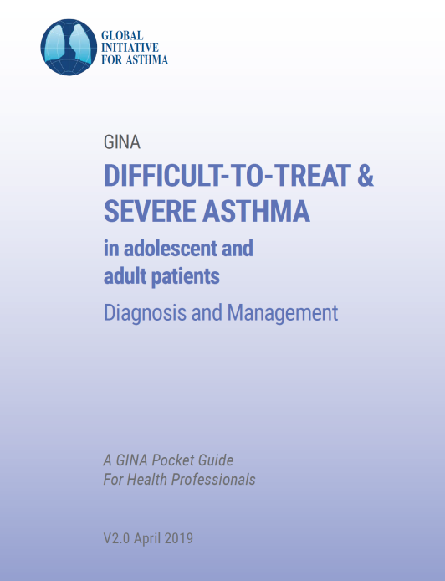
Other changes in GINA 2019 – severe asthma
Pocket guide about difficult-to-treat and severe asthma
A practical guide for primary and specialist care
Includes a decision tree about assessment and management of adults and adolescents with uncontrolled asthma or exacerbations despite Step 4-5 treatment
Includes strategies for clinical settings in which biologic therapy is not available or affordable
First published in November 2018
V2.0 Pocket Guide published April 2018
Also included in full GINA 2019 report
Includes anti-IL4 receptor alpha (dupilumab)
Extension of biologic treatment trial to 6-12 months if response to initial therapy is unclear

Slide 30
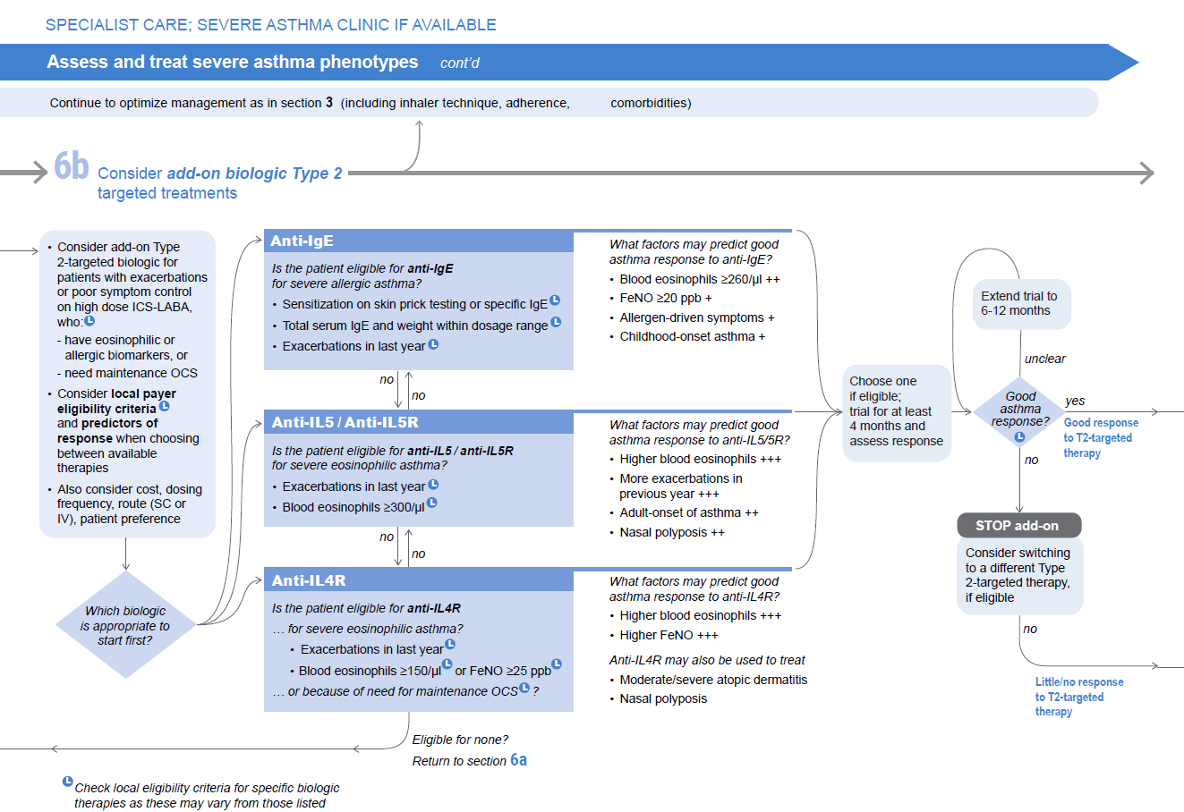
Notes:
This slide shows a page from the decision tree in v2.0 pocket guide – addition of dupilumab, and of prompt for extension of treatment trial if response is unclear

Slide 31
Other changes in GINA 2019
Updated strategies for ‘yellow zone’ of action plans, with new evidence
4x increase in ICS dose decreased severe exacerbations in pragmatic study in adults (McKeever, NEJMed 2018)
5x increase in ICS dose did not decrease severe exacerbations in children with good symptom control and high adherence (Jackson, NEJMed 2018)
Pre-school asthma
Additional suggestions for investigating history of wheezing episodes
Early referral recommended if child fails to respond to controller treatment
For exacerbations, OCS not generally recommended except in ED setting
Follow-up after ED or hospital: within 1-2 working days and 3-4 weeks later
Pocket guide on management of asthma in children 5 years and younger will be updated in 2019

Slide 32
Questions?

